Slide 2
Introduction
Why another interface between LabVIEW™ and EPICS?
The technical realisation of the project
How is the handling for end users?
Carsten Winkler A lightweight LabVIEW™-EPICS-Interface
2

Slide 3
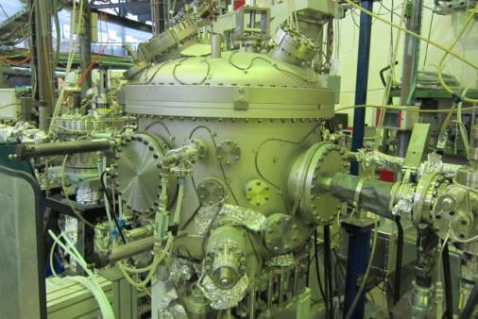
Reasons
Guest researchers at BESSY like LabVIEW™
Beamlines are operable via EPICS
Operation status of BESSY is available via EPICS
Calling for suitable interface
Carsten Winkler A lightweight LabVIEW™-EPICS-Interface
3

Slide 4
Requirements
free of charge
easy handling
open source
low network load
Support of consistent fields
interface
support of 32- and 64 bit
Windows® & Linux
fast IO
support of large arrays
support of old LabVIEW™ versions
support of user events
Carsten Winkler A lightweight LabVIEW™-EPICS-Interface
4

Slide 5
Free Solutions in 2009
EPICS I/O Client from
LabVIEW™ Channel Access Client from
... some more
Significant problems
Carsten Winkler A lightweight LabVIEW™-EPICS-Interface
5

Slide 6
Existing difficulties
Dependency of external services
Error-prone for newcomers
Incomplete implementations of
Data types
EPICS fields
Enumerations
Carsten Winkler A lightweight LabVIEW™-EPICS-Interface
6

Slide 7
Solution
Directly based on the EPICS base
Supports all EPICS data types
Any number of consistent fields per EPICS variable
LabVIEW™ 7.0 to 2012 on Windows® and Linux
Monitoring und Caching → low network load
Carsten Winkler A lightweight LabVIEW™-EPICS-Interface
7

Slide 8
Solution
EPICS client only
Not available for realtime units
3 additional native libraries
CaLab
ca (EPICS base)
Com (EPICS base)
8

Slide 9
Solution
request PV
first call
timeout
well-known PV?
NO
init PV
YES
get cached value(s)
monitor
add monitor to PV
wait 4 value
return value(s)
timeout
Carsten Winkler A lightweight LabVIEW™-EPICS-Interface
9

Slide 10
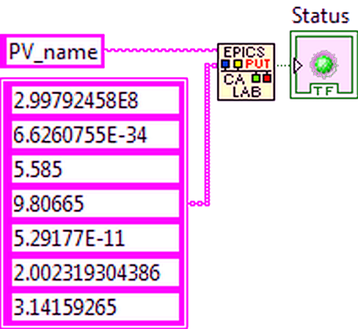
Practice
write value
read value
read value
event
Carsten Winkler A lightweight LabVIEW™-EPICS-Interface
10

Slide 11
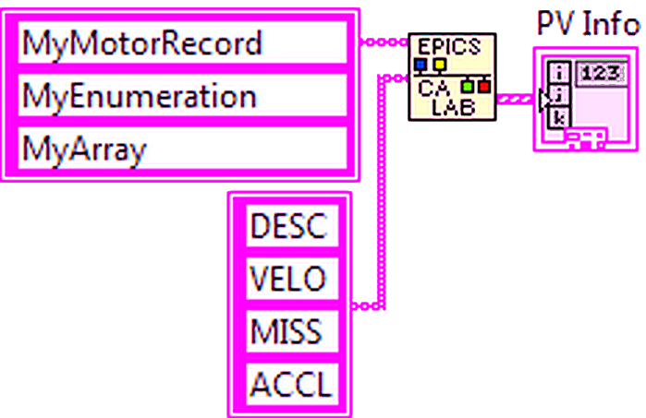
Practice
names
any data type
arrays
fields

Slide 12
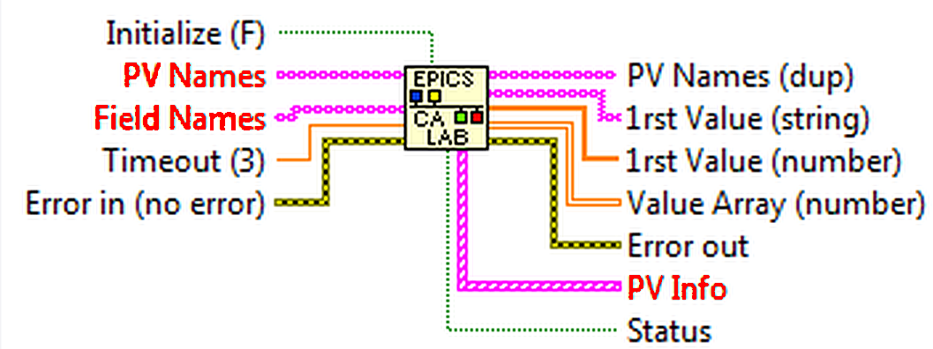
Practice
caLabGet.vi

Slide 13
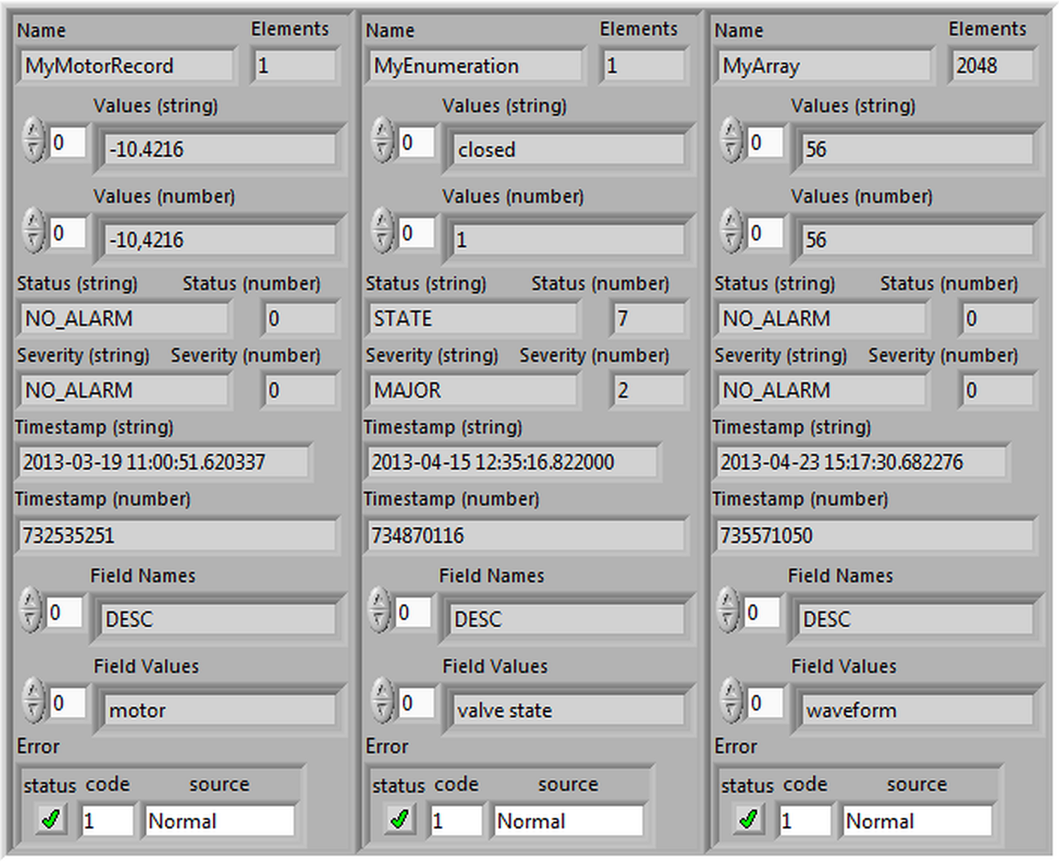
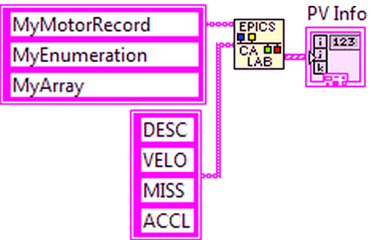
Practice
arrays
enums
consistence
13

Slide 14
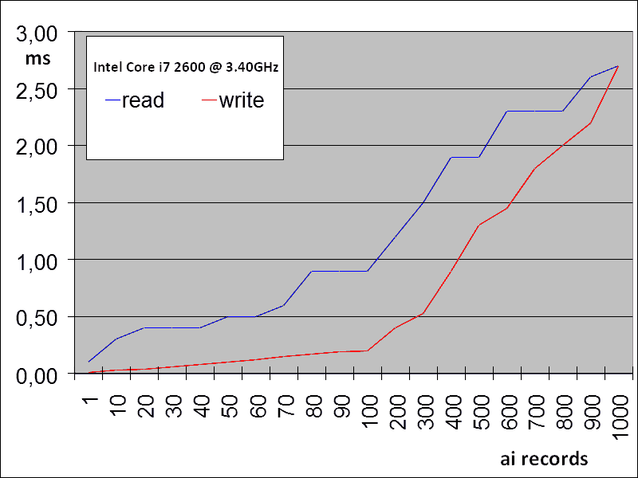
Performance
Carsten Winkler A lightweight LabVIEW™-EPICS-Interface
14

Slide 15
Conclusion
Very easy handling of EPICS variables in LabVIEW™
All requirements have been met
In use at BESSY since 2009 (beamline control, machine tools)
Continuous development
Better error handling in VIs
Carsten Winkler A lightweight LabVIEW™-EPICS-Interface
15

Slide 16
http://tinyurl.com/calab2013
Carsten Winkler A lightweight LabVIEW™-EPICS-Interface
16

